Slide 1
Spring Framework

Slide 2
Spring Overview
Spring is an open source layered Java/J2EE application framework
Created by Rod Johnson
Based on book “Expert one-on-one J2EE Design and Development” (October, 2002)
Current version 2.0.6 (released on 2007-06-18)
The Spring Framework is licensed under the terms of the Apache License, Version 2.0 and can be downloaded at:
http://www.springframework.org/download
Philosophy: J2EE should be easier to use, “Lightweight Container” concept
A software framework is a re-usable design for a software system.

Slide 3
What are Lightweight Frameworks?
Non-intrusive
No container requirements
Simplify application development
Remove re-occurring pattern code
Productivity friendly
Unit test friendly
Very pluggable
Usually open source
Examples:
Spring, Pico, Hivemind
Hibernate, IBatis, Castor
WebWork
Quartz
Sitemesh

Slide 4
Spring Mission Statement
J2EE should be easier to use
It's best to program to interfaces, rather than classes. Spring reduces the complexity cost of using interfaces to zero.
JavaBeans offer a great way of configuring applications
OO design is more important than any implementation technology, such as J2EE
Checked exceptions are overused in Java. A framework shouldn't force you to catch exceptions you're unlikely to be able to recover from.
Testability is essential, and a framework such as Spring should help make your code easier to test
Spring should be a pleasure to use
Your application code should not depend on Spring APIs
Spring should not compete with good existing solutions, but should foster integration. (For example, JDO and Hibernate are great O/R mapping solutions. Don't need to develop another one).

Slide 5
Modules of the Spring Framework
The Spring Framework can be considered as a collection of frameworks-in-the-framework:
Core - Inversion of Control (IoC) and Dependency Injection
AOP - Aspect-oriented programming
DAO - Data Access Object support, transaction management, JDBC-abstraction
ORM - Object Relational Mapping data access, integration layers for JPA, JDO, Hibernate, and iBatis
MVC - Model-View-Controller implementation for web-applications
Remote Access, Authentication and Authorization, Remote Management, Messaging Framework, Web Services, Email, Testing, …

Slide 6
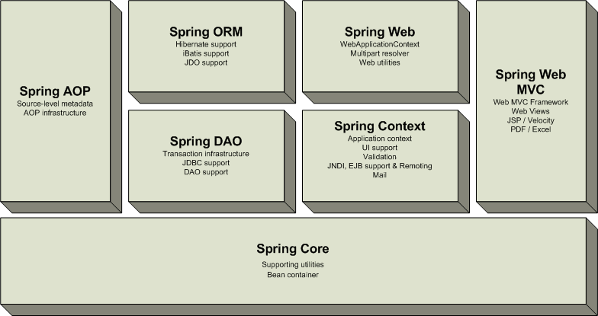
Overview of the Spring Framework
Very loosely coupled, components widely reusable and separately packaged.

Slide 7
Spring Details
Spring allows to decouple software layers by injecting a component’s dependencies at runtime rather than having them declared at compile time via importing and instantiating classes.
Spring provides integration for J2EE services such as EJB, JDBC, JNDI, JMS, JTA. It also integrates several popular ORM toolkits such as Hibernate and JDO and assorted other services as well.
One of the highly touted features is declarative transactions, which allows the developer to write transaction-unaware code and configure transactions in Spring config files.
Spring is built on the principle of unchecked exception handling. This also reduces code dependencies between layers. Spring provides a granular exception hierarchy for data access operations and maps JDBC, EJB, and ORM exceptions to Spring exceptions so that applications can get better information about the error condition.
With highly decoupled software layers and programming to interfaces, each layer is easier to test. Mock objects is a testing pattern that is very useful in this regard.

Slide 8
Advantages of Spring Architecture
Enable you to write powerful, scalable applications using POJOs
Lifecycle – responsible for managing all your application components, particularly those in the middle tier container sees components through well-defined lifecycle: init(), destroy()
Dependencies - Spring handles injecting dependent components without a component knowing where they came from (IoC)
Configuration information - Spring provides one consistent way of configuring everything, separate configuration from application logic, varying configuration
In J2EE (e.g. EJB) it is easy to become dependent on container and deployment environment, proliferation of pointless classes (locators/delegates); Spring eliminates them
Cross-cutting behavior (resource management is cross-cutting concern, easy to copy-and-paste everywhere)
Portable (can use server-side in web/ejb app, client-side in swing app, business logic is completely portable)

Slide 9
Spring Solutions
Solutions address major J2EE problem areas:
Web application development (MVC)
Enterprise Java Beans (EJB, JNDI)
Database access (JDBC, iBatis, ORM)
Transaction management (JTA, Hibernate, JDBC)
Remote access (Web Services, RMI)
Each solution builds on the core architecture
Solutions foster integration, they do not re-invent the wheel

Slide 10
How to Start Using Spring
Download Spring from www.springframework.org, e.g.
spring-framework-2.0.6-with-dependencies.zip
Unzip to some location, e.g.
C:\tools\spring-framework-2.0.6
Folder C:\tools\spring-framework-2.0.6\dist
contains Spring distribution jar files
Add libraries to your application classpath
and start programming with Spring

Slide 11
Inversion of Control (IoC)
Central in the Spring is its Inversion of Control container
Based on “Inversion of Control Containers and the Dependency Injection pattern” (Martin Fowler)
Provides centralized, automated configuration, managing and wiring of application Java objects
Container responsibilities:
creating objects,
configuring objects,
calling initialization methods
passing objects to registered callback objects
etc
All together form the object lifecycle which is one of the most important features
Java objects that are managed by the Spring IoC container are referred to as beans

Slide 12
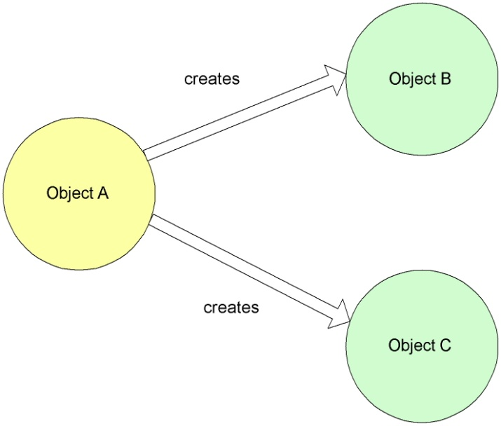
Dependency Injection – Non-IoC
public class MainBookmarkProcessor implements BookmarkProcessor{
private PageDownloader pageDownloader;
private RssParser rssParser;
public List<Bookmark> loadBookmarks()
{
// direct initialization
pageDownloader = new ApachePageDownloader();
rssParser = new JenaRssParser();
// or factory initialization
// pageDownloader = PageDownloaderFactory.getPageDownloader();
// rssParser = RssParserFactory.getRssParser();
// use initialized objects
pageDownloader.downloadPage(url);
rssParser.extractBookmarks(fileName, resourceName);
// ...
}

Slide 13
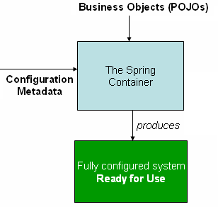
Dependency Injection - IoC
Beans define their dependencies through constructor arguments or properties
Container resolves (injects) dependencies of components by setting implementation object during runtime
BeanFactory interface - the core that
loads bean definitions and manages beans
Most commonly used implementation
is the XmlBeanFactory class
Allows to express the objects that compose
application, and the interdependencies
between such objects, in terms of XML
The XmlBeanFactory takes this XML
configuration metadata and uses it to create a fully configured system

Slide 14

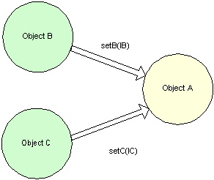
Non-IoC versus IoC
Non Inversion of Control approach
Inversion of Control approach

Slide 15
IoC Basics
Basic JavaBean pattern:
include a “getter” and “setter” method for each field:
Rather than locating needed resources, application components provide setters through which resources are passed in during initialization
In Spring Framework, this pattern is used extensively, and initialization is usually done through configuration file rather than application code
class MyBean {
private int counter;
public int getCounter()
{ return counter; }
public void setCounter(int counter)
{ this.counter = counter; }
}

Slide 16
IoC Java Bean
public class MainBookmarkProcessor implements BookmarkProcessor{
private PageDownloader pageDownloader;
private RssParser rssParser;
public List<Bookmark> loadBookmarks()
{
pageDownloader.downloadPage(url);
rssParser.extractBookmarks(fileName, resourceName);
// ...
}
public void setPageDownloader(PageDownloader pageDownloader){
this.pageDownloader = pageDownloader;
}
public void setRssParser(RssParser rssParser){
this.rssParser = rssParser;
}

Slide 17
References
Spring Home:
http://www.springframework.org
Inversion of Control Containers and the Dependency Injection pattern http://www.martinfowler.com/articles/injection.html
Spring IoC Container:
http://static.springframework.org/spring/docs/2.0.x/reference/beans.html
Introduction to the Spring Framework by Rod Johnson
http://www.theserverside.com/tt/articles/article.tss?l=SpringFramework

